Slide 1

EC 244 : MINI-PROJECT 1
Automatic Light Control system
NAME: Singh Amartya
ID: 17EC088
BRANCH: EC-2

Slide 2
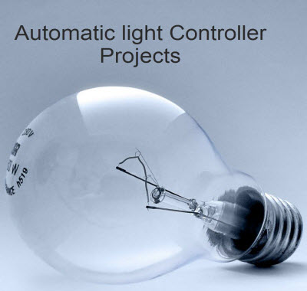
INTRODUCTION:
Automatic Light Control System controls the operation of light by detecting the light outside i.e. it can switch ON the light when it’s dark outside & it can also switch it OFF when its bright outside.
Thus this system reduces the effort to manually switching the light ON/OFF.

Slide 3
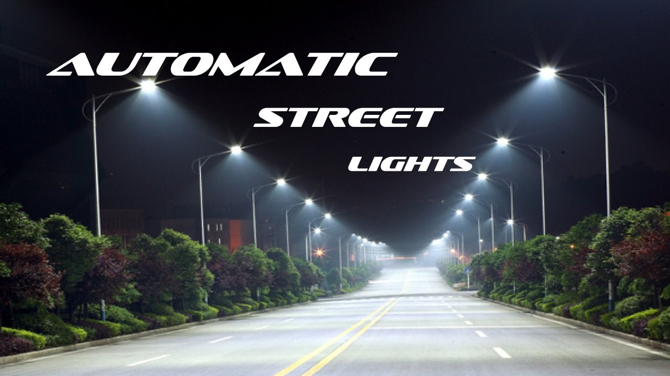
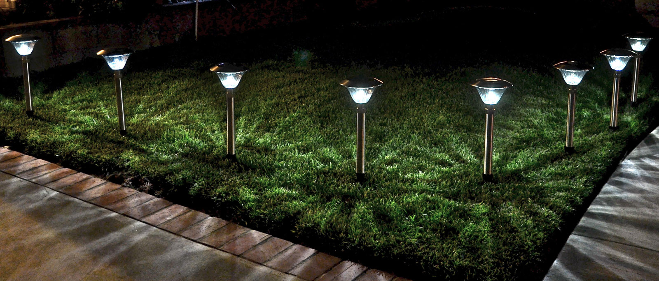
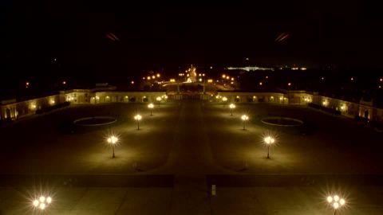
Uses:
Street Lights
Home lights
Public Building lights

Slide 4


Benefits:
Energy Efficient
No manpower required after one time installation
Requires less maintenance
Consistency

Slide 5
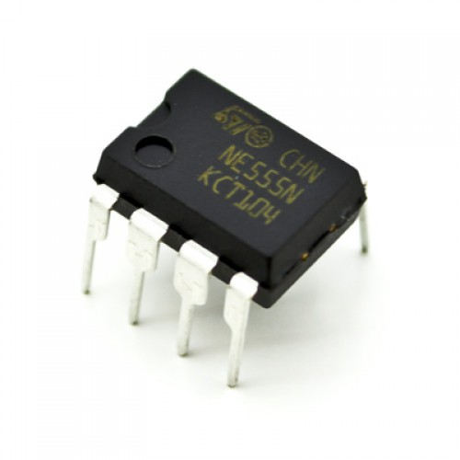
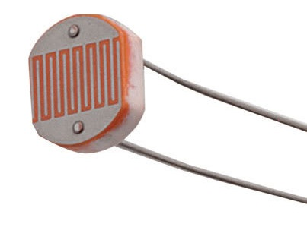
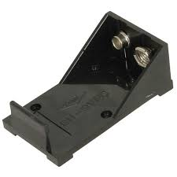
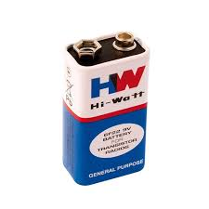
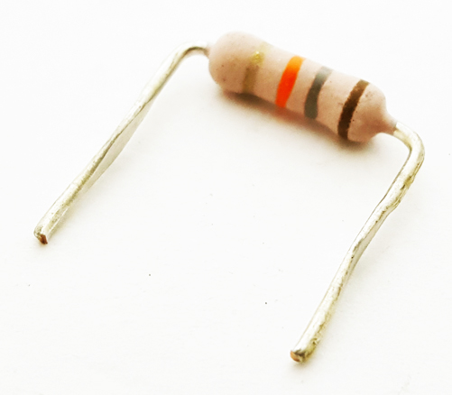
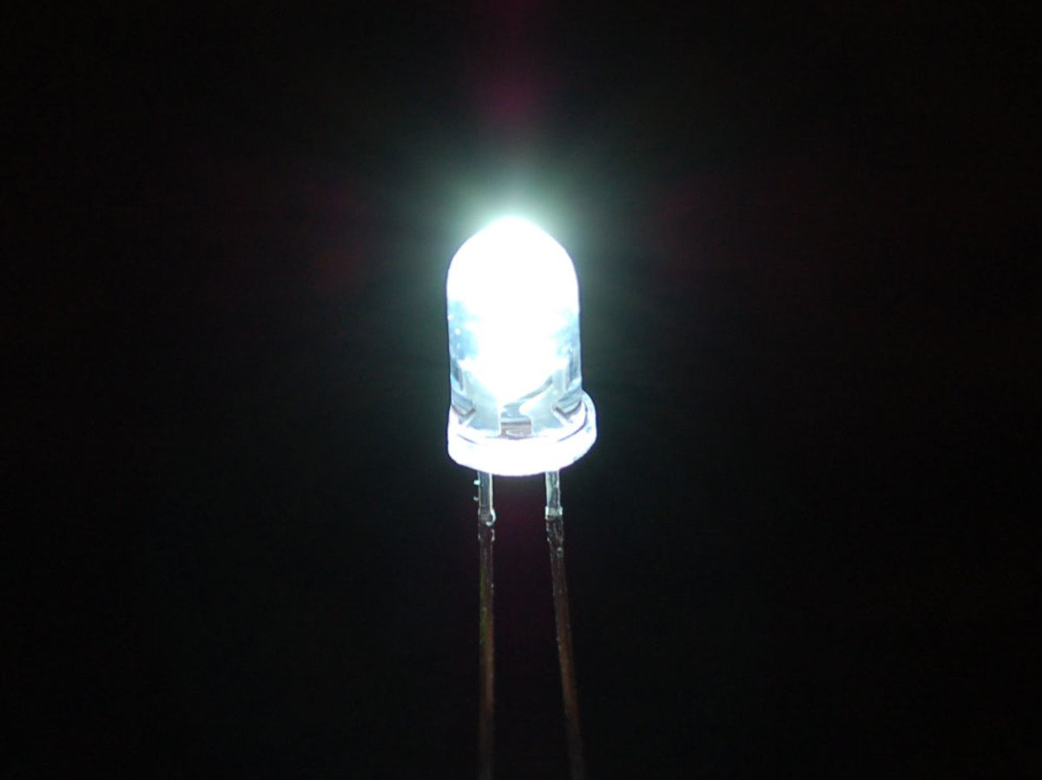
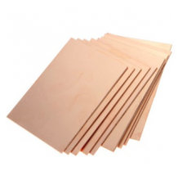
Components:
PCB / BREADBOARD
555 Timer IC
LDR (100 – 1M ohms)
LED (representing lights)
DC voltage source
Resistors (1*1k Ω , 1*20k Ω & 1*220 Ω)
Battery Holder

Slide 6
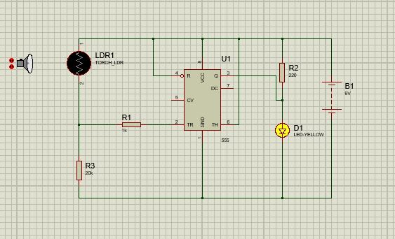
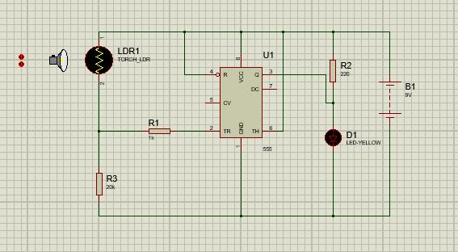
Here light source is off so our LED turns ON
Here light source is on so our LED turns OFF

Slide 7
THANK YOU

